Slide 1

Pointers & Arrays

Slide 2
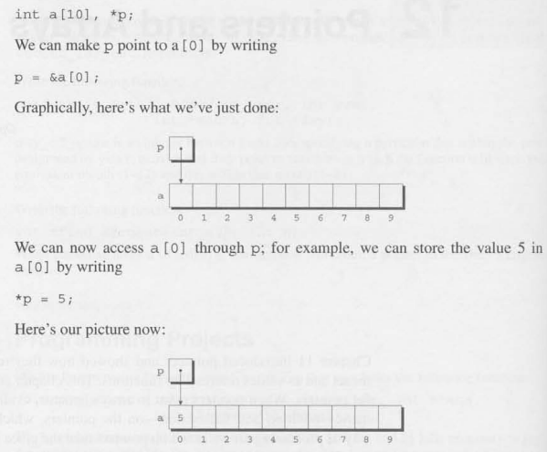
Pointer Arithmetic

Slide 3
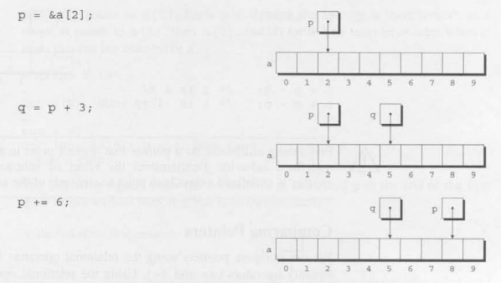
Pointer Arithmetic: Adding an integer to a pointer

Slide 4
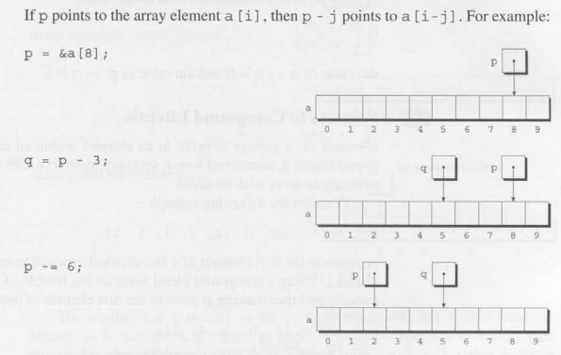
Pointer Arithmetic: Subtracting an integer to a pointer

Slide 5

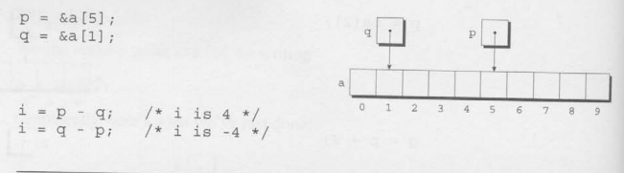
Pointer Arithmetic: Adding/Subtracting one pointer to another

Slide 6
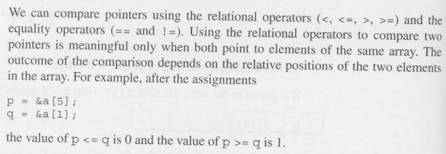
Comparing Pointers

Slide 7
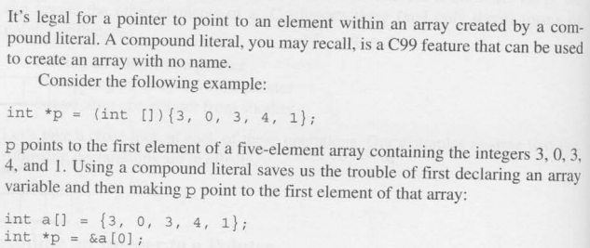
POINTERS TO COMPOUND LITERALS

Slide 8
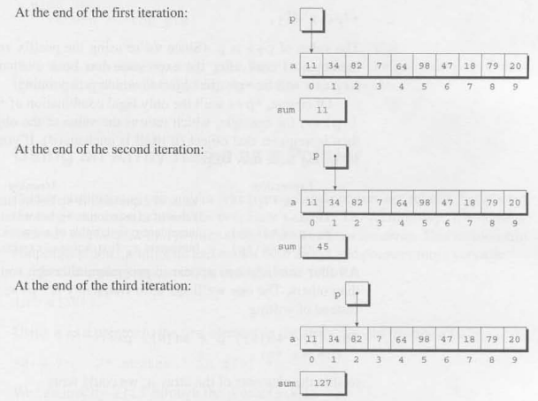
USING POINTERS TO ARRAY PROCESSING

Slide 9

COMBINING THE * AND ++ OPERATORS

Slide 10
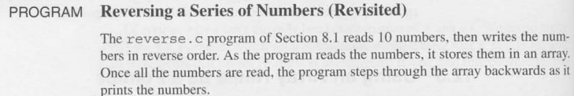
USING AN ARRAY NAME AS A POINTER & ARRAY ARGUMENT

Slide 11
THE END

